Slide 1


Internet Health Report
How healthy is
the Internet?

Slide 2

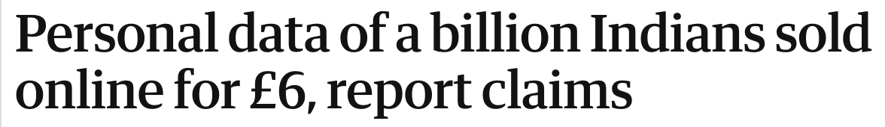

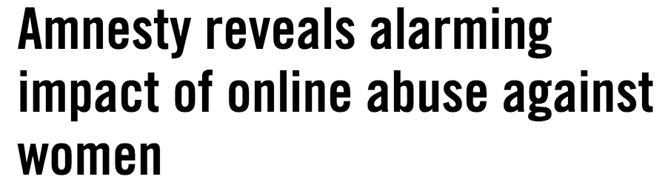
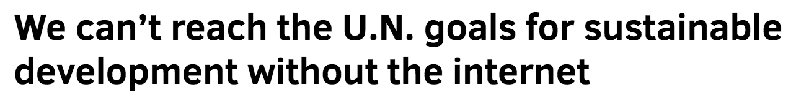
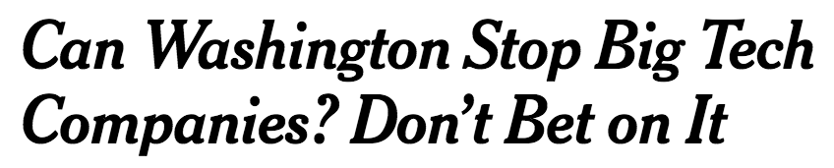

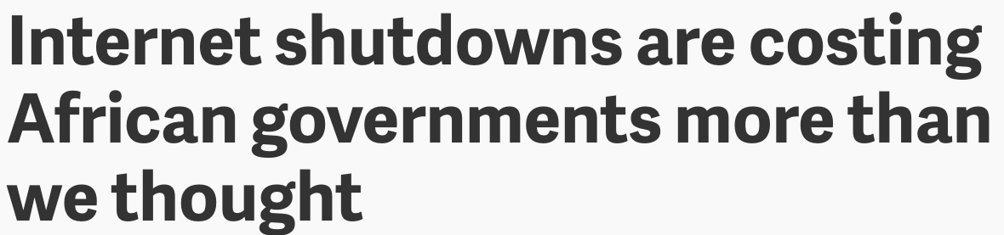
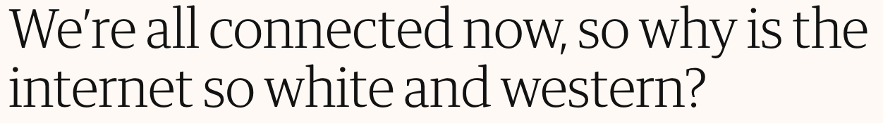
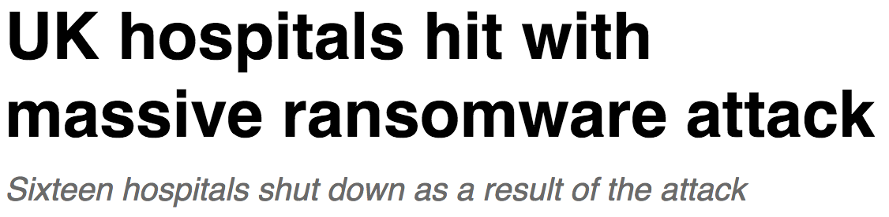
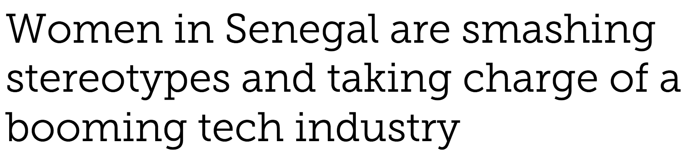
Internet Health Report

Slide 3
Internet Health Report
What is it? The Five Issues Why Mozilla Cares What Can You Do?
Well first, what does Mozilla mean by “Internet Health?”

Slide 4

Internet Health Report
The internet is an ecosystem.
Notes:
Like an ecosystem, the internet has parts that are healthy, helping its life forms to thrive.
But it also has parts that are unhealthy, causing its life forms to deteriorate.
Like an ecosystem, the internet adapts to human behavior and changes through deliberate action.

Slide 5
Internet Health Report
The internet ecosystem is a global, public resource that belongs to us all equally.
Notes:
A healthy internet is a platform for economic opportunity, creativity, personal connection, free expression and democracy around the world.
The health of this system relies on – and influences – everyone it touches. Signs of poor health in any part impacts the whole.
As some of the billions of people who depend on the internet for our lives and livelihoods, it’s our responsibility to build and sustain a healthy Internet.

Slide 6
Internet Health Report
What is it? The Five Issues Why Mozilla Cares What Can You Do?
Okay, so what exactly is the
“Internet Health Report”?

Slide 7
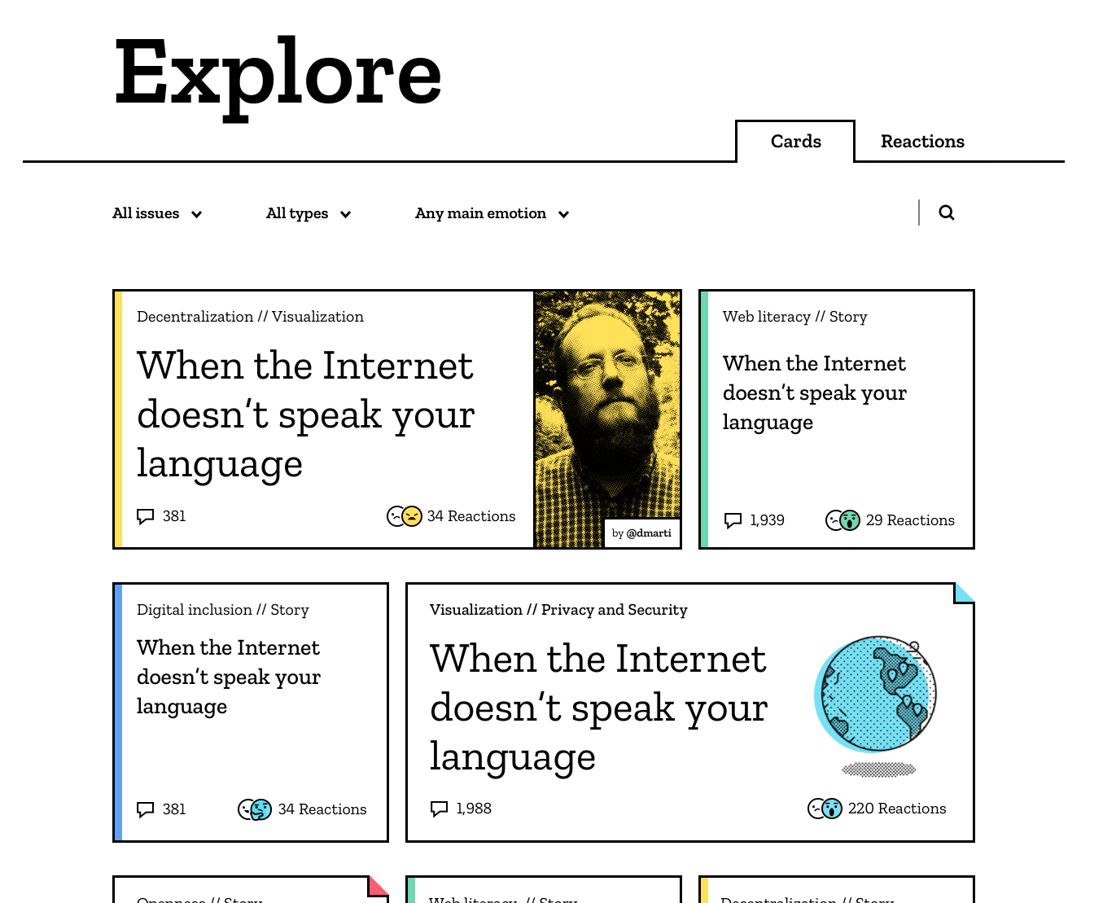
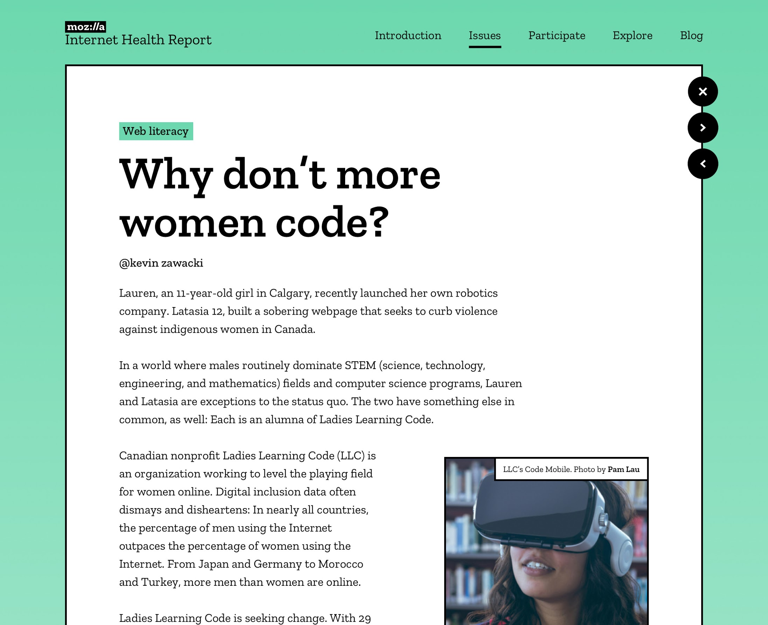
Internet Health Report
What is it? The Five Issues Why Mozilla Cares What Can You Do?
It’s an open source initiative to document and explain what’s happening to the health of the internet.

Slide 8
Internet Health Report
What is it? The Five Issues Why Mozilla Cares What Can You Do?
Research, stories and public comments from around the world contribute to the annual Internet Health Report.
Notes:
Every year, the internet gets healthier in some ways and unhealthier in others. Getting the balance right is what we need for the Internet to be a resource for good.
The Internet Health Report provides a snapshot of the current state of internet health by bringing together stories and research about legal, social, technical and commercial aspects of the Internet worldwide, and encouraging us to discuss the question: “How is the internet getting healthier or unhealthier?”

Slide 9
Internet Health Report
What is it? The Five Issues Why Mozilla Cares What Can You Do?
The report covers five internet health issues.
Privacy and security Openness Digital Inclusion Web Literacy Decentralization

Slide 10

Internet Health Report
What is it? The Five Issues Why Mozilla Cares What Can You Do?
Privacy and security
Privacy and security // Story
Meet the Internet’s FIRST responders to security emergencies
Is it safe?
Notes:
Margrete Raaum in Norway is a computer systems expert, and a member and the former chairwoman of FIRST (Forum for Incident Response and Security Teams), a global network of volunteer cybersecurity experts.
FIRST – active in more than 80 countries – got its start 28 years ago when the Internet was in its infancy. “In November 1988, a computer security incident known as the ‘Internet worm’ brought major portions of the Internet to its knees,” reads FIRST’s history webpage. “Reaction to this incident was isolated and uncoordinated, resulting in much duplicated effort, and in conflicting solutions.”
Today, FIRST has a broad scope: It deploys response teams to address incidents around the world. The network creates cybersecurity tools, works on malware analysis standards and develops recommendations for Internet governance. FIRST also provides fellowships for cybersecurity experts around the world, last year in Panama, Vietnam, Ecuador and Moldova.
Read more: https://internethealthreport.org/2018/meet-the-internets-first-responders-to-security-emergencies/

Slide 11
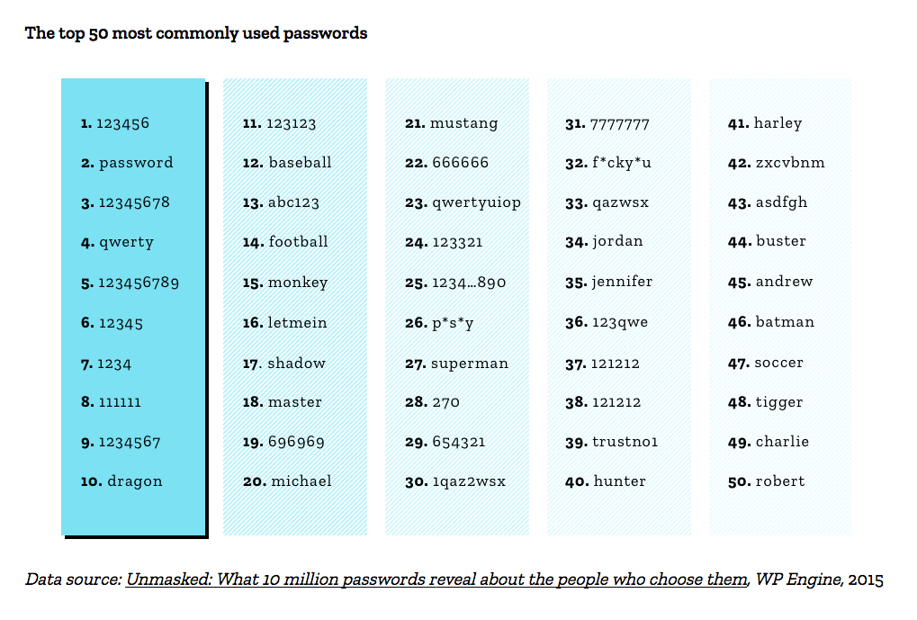
Internet Health Report
Notes:
The top 50 passwords among 10 million leaked logins reveal a lot about what we can do to improve security on the Web
A report by WP Engine from 2015 analyzes passwords gathered from the Web and shared openly for security research purposes. Based on frequency, WP Engine estimates that 16 out of 1,000 passwords could be guessed simply by using the top 10.
“Unmasked: What 10 million passwords reveal about the people who choose them” describes the average length of passwords (8 characters), average strength (weak), and demonstrates how most people use passwords that are easy to crack because the words, numbers, or keyboard typing patterns they use are predictable.
Read more: https://internethealthreport.org/2018/the-top-50-passwords-could-easily-be-better/

Slide 12

Internet Health Report
What is it? The Five Issues Why Mozilla Cares What Can You Do?
Openness
Openness // Story
Resisting a Whatsapp and Telegram ban in Afghanistan
How open is it?
Notes:
On the first day of November 2017, with no warning, Afghanistan’s Ministry of Information and Technology ordered Internet service providers to block the messaging apps WhatsApp and Telegram for a 20-day test ban. The restriction was felt almost immediately when the following day a state-owned telecommunications company enacted the ban, cutting countless people off from the popular platforms.
The government cited vague “security reasons” for the ban, but citizens were unconvinced. They saw the move as censorship and feared the ban could be extended to other platforms, such as Facebook. It was rumored but not confirmed that the intention was to stop the Taliban’s use of end-to-end encryption of chats, a security feature of both apps that benefits all users.
The government was met with a swift and vocal public backlash, most notably on Facebook. Within days the ban was repealed and access to both messaging apps was restored for all citizens. In an attempt to address public fears, the government cited the Afghan constitution’s guarantee of free speech in its announcement of the reversal of the ban.
Read more: https://internethealthreport.org/2018/resisting-a-whatsapp-and-telegram-ban-in-afghanistan/

Slide 13
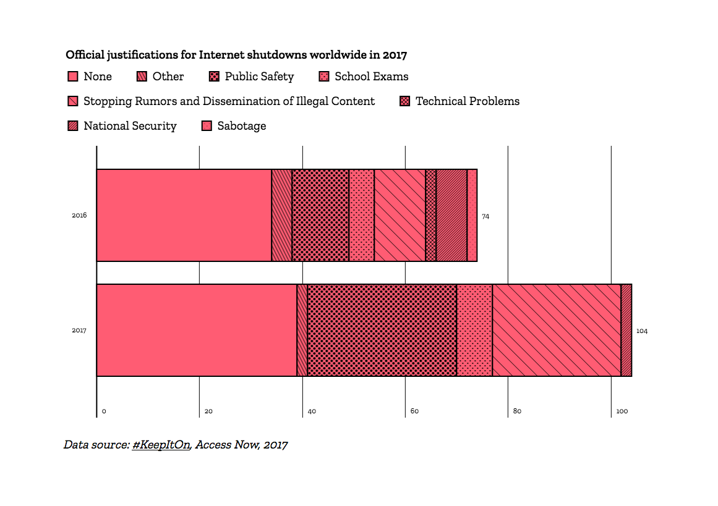
Internet Health Report
Notes:
The majority of shutdowns last year occurred in Asia and Africa with justifications ranging from “reactive” in response to conflicts or political activity, or “preventive” to stop undesired activity.
Last year, nearly 7% of shutdowns were attributed to preventing cheating in school exams, while just over a quarter of official justifications fell into the broad category of “public safety.” In somewhat positive news, the number of shutdowns with no asserted rationale has shrunk.
Sometimes only mobile connections are affected, but this is often the only Internet widely available.
Shutdowns are unhealthy for the Internet. We need more legal safeguards against them, nationally and internationally. With more research and evidence-gathering to determine how many shutdowns occur and why, we can hone in on tactics and technologies to stop them for good.
Read more: https://internethealthreport.org/2018/internet-shutdowns-are-rising/

Slide 14

Internet Health Report
What is it? The Five Issues Why Mozilla Cares What Can You Do?
Digital Inclusion
Digital Inclusion // Story
New approaches to rural Internet connectivity
Who is welcome?
Notes:
In rural and low-income regions worldwide, including in Europe and North America, access can be slow, scarce or nonexistent. Companies and governments often consider expanding communications infrastructure simply too costly, or a low priority.
Even in wealthy cities that boast lightning fast Internet speeds and claim universal availability, residents can find themselves priced out of services.
The Gram Marg project at the Indian Institute of Technology Bombay hopes to connect thousands of rural villages across India. One of their techniques is to leverage unutilized television spectrums to transmit low-cost, wide-range Internet connectivity, so-called frugal 5G.
In South Africa, the non-profit Project Isizwe deploys free, fast Wi-Fi across low-income communities through a variety of financial models: access can be subsidized by municipal governments or unlocked by engaging with a sponsor’s content. In one community, Wi-Fi vouchers are earned by recycling household litter.
Read more: https://internethealthreport.org/2018/new-approaches-to-rural-internet-connectivity/

Slide 15
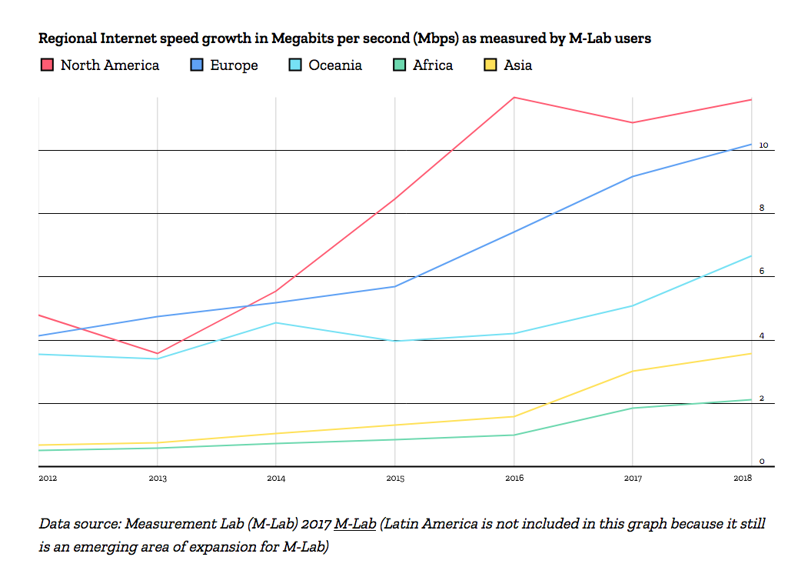
Internet Health Report
Notes:
Where you live plays a decisive role in whether or not you can dependably use the Internet. When the Internet slows to a crawl it’s difficult to do simple things like watch a video, listen to a song, or even load an article on a newspaper website. A slow Internet is not a healthy Internet.
According to open data from Measurement Lab based on over 1 billion user generated Internet speed tests worldwide, the median speeds people experience accessing content on the Internet have been getting faster in all regions since 2012.
Individual countries stand out with either higher or lower than regional average speeds, but on average North America and Europe enjoy the fastest speeds and Africa the slowest.
Read more: https://internethealthreport.org/2018/is-the-internet-getting-faster-for-you/

Slide 16


Internet Health Report
What is it? The Five Issues Why Mozilla Cares What Can You Do?
Web Literacy
Web Literacy // Story
Django Girls: Communities of code from Argentina to Zimbabwe
Who can succeed?
Notes:
Django, is the name of an open source development toolbox for building websites and apps. Django Girls is a global, community-led organization that offers free manuals and tutorials to help anyone organize a one-day workshop for women who want to learn Web programming.
Since 2014, they have held more than 590 events in 378 cities for over 12,000 women. Recent events took place in Río Cuarto, Argentina; Port Harcourt, Nigeria and Bangalore, India. Today, Django Girls counts over 1,300 volunteers in 84 countries.
Read more: https://internethealthreport.org/2018/django-girls-communities-of-code-from-argentina-to-zimbabwe/

Slide 17
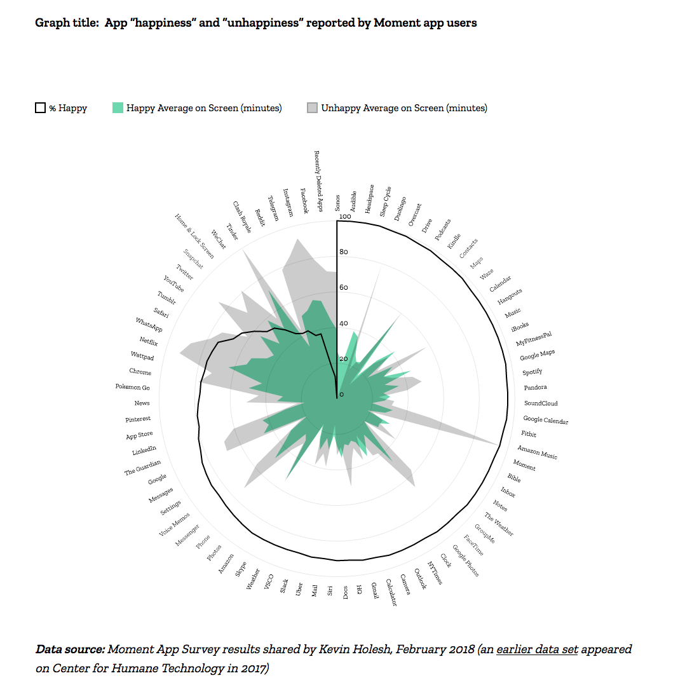
Internet Health Report
Notes:
At Moment — a free Apple iOS app that tracks users’ screen time and helps them limit their app usage — the team recently partnered with the Center for Humane Technology, an initiative that questions technology’s impact on human well being, to determine what apps leave us most happy, and which leave us most unhappy.
The goal: To encourage more self-awareness about app use and offer some impetus to change negative habits.
For the project, Moment asked thousands of users (mostly based in the United States and Europe) a simple, yes or no question about the apps they use on their phones: “Are you happy with your time spent?”
An important component of the data is the amount of time spent using an app. “I wanted to find the happiness breaking point for each app,” explains Moment designer Kevin Holesh who shares regular updates and musings on Moment user statistics on Twitter.
In the case of Facebook, Moment found that point to be 18 minutes a day. Such moderate usage was found to even boost an app user’s mood. But 47 minutes veered into unhappy territory.
Read more: https://internethealthreport.org/2018/do-the-mobile-apps-we-use-the-most-make-us-unhappy/

Slide 18

Internet Health Report
What is it? The Five Issues Why Mozilla Cares What Can You Do?
Decentralization
Decentralization // Story
The world’s first ambassador to technology companies
Who controls it?
Notes:
As a career diplomat for the Kingdom of Denmark, Casper Klynge was previously stationed in Indonesia.
Now, with a team distributed between Copenhagen, Silicon Valley and Beijing, China, he spearheads a diplomatic mission to technology companies, some of whose gross incomes rival those of his entire country. He is the world’s first official ambassador to the tech sector.
The diplomatic role of the new Danish representation is not only to establish links between the public and private sectors. Klynge also wants to rethink the relationship between governments, the private sector and civil society.
“You can no longer distinguish these three actors in a traditional way,” he says. “There is a value dimension in technology that is sometimes overlooked, which is ‘How do you make sure that new technology is coherent with democratic values, human rights, inclusiveness, etc.?’ This is where I think civil society has a very important voice.”
Read more at: https://internethealthreport.org/2018/the-worlds-first-ambassador-to-technology-companies/

Slide 19
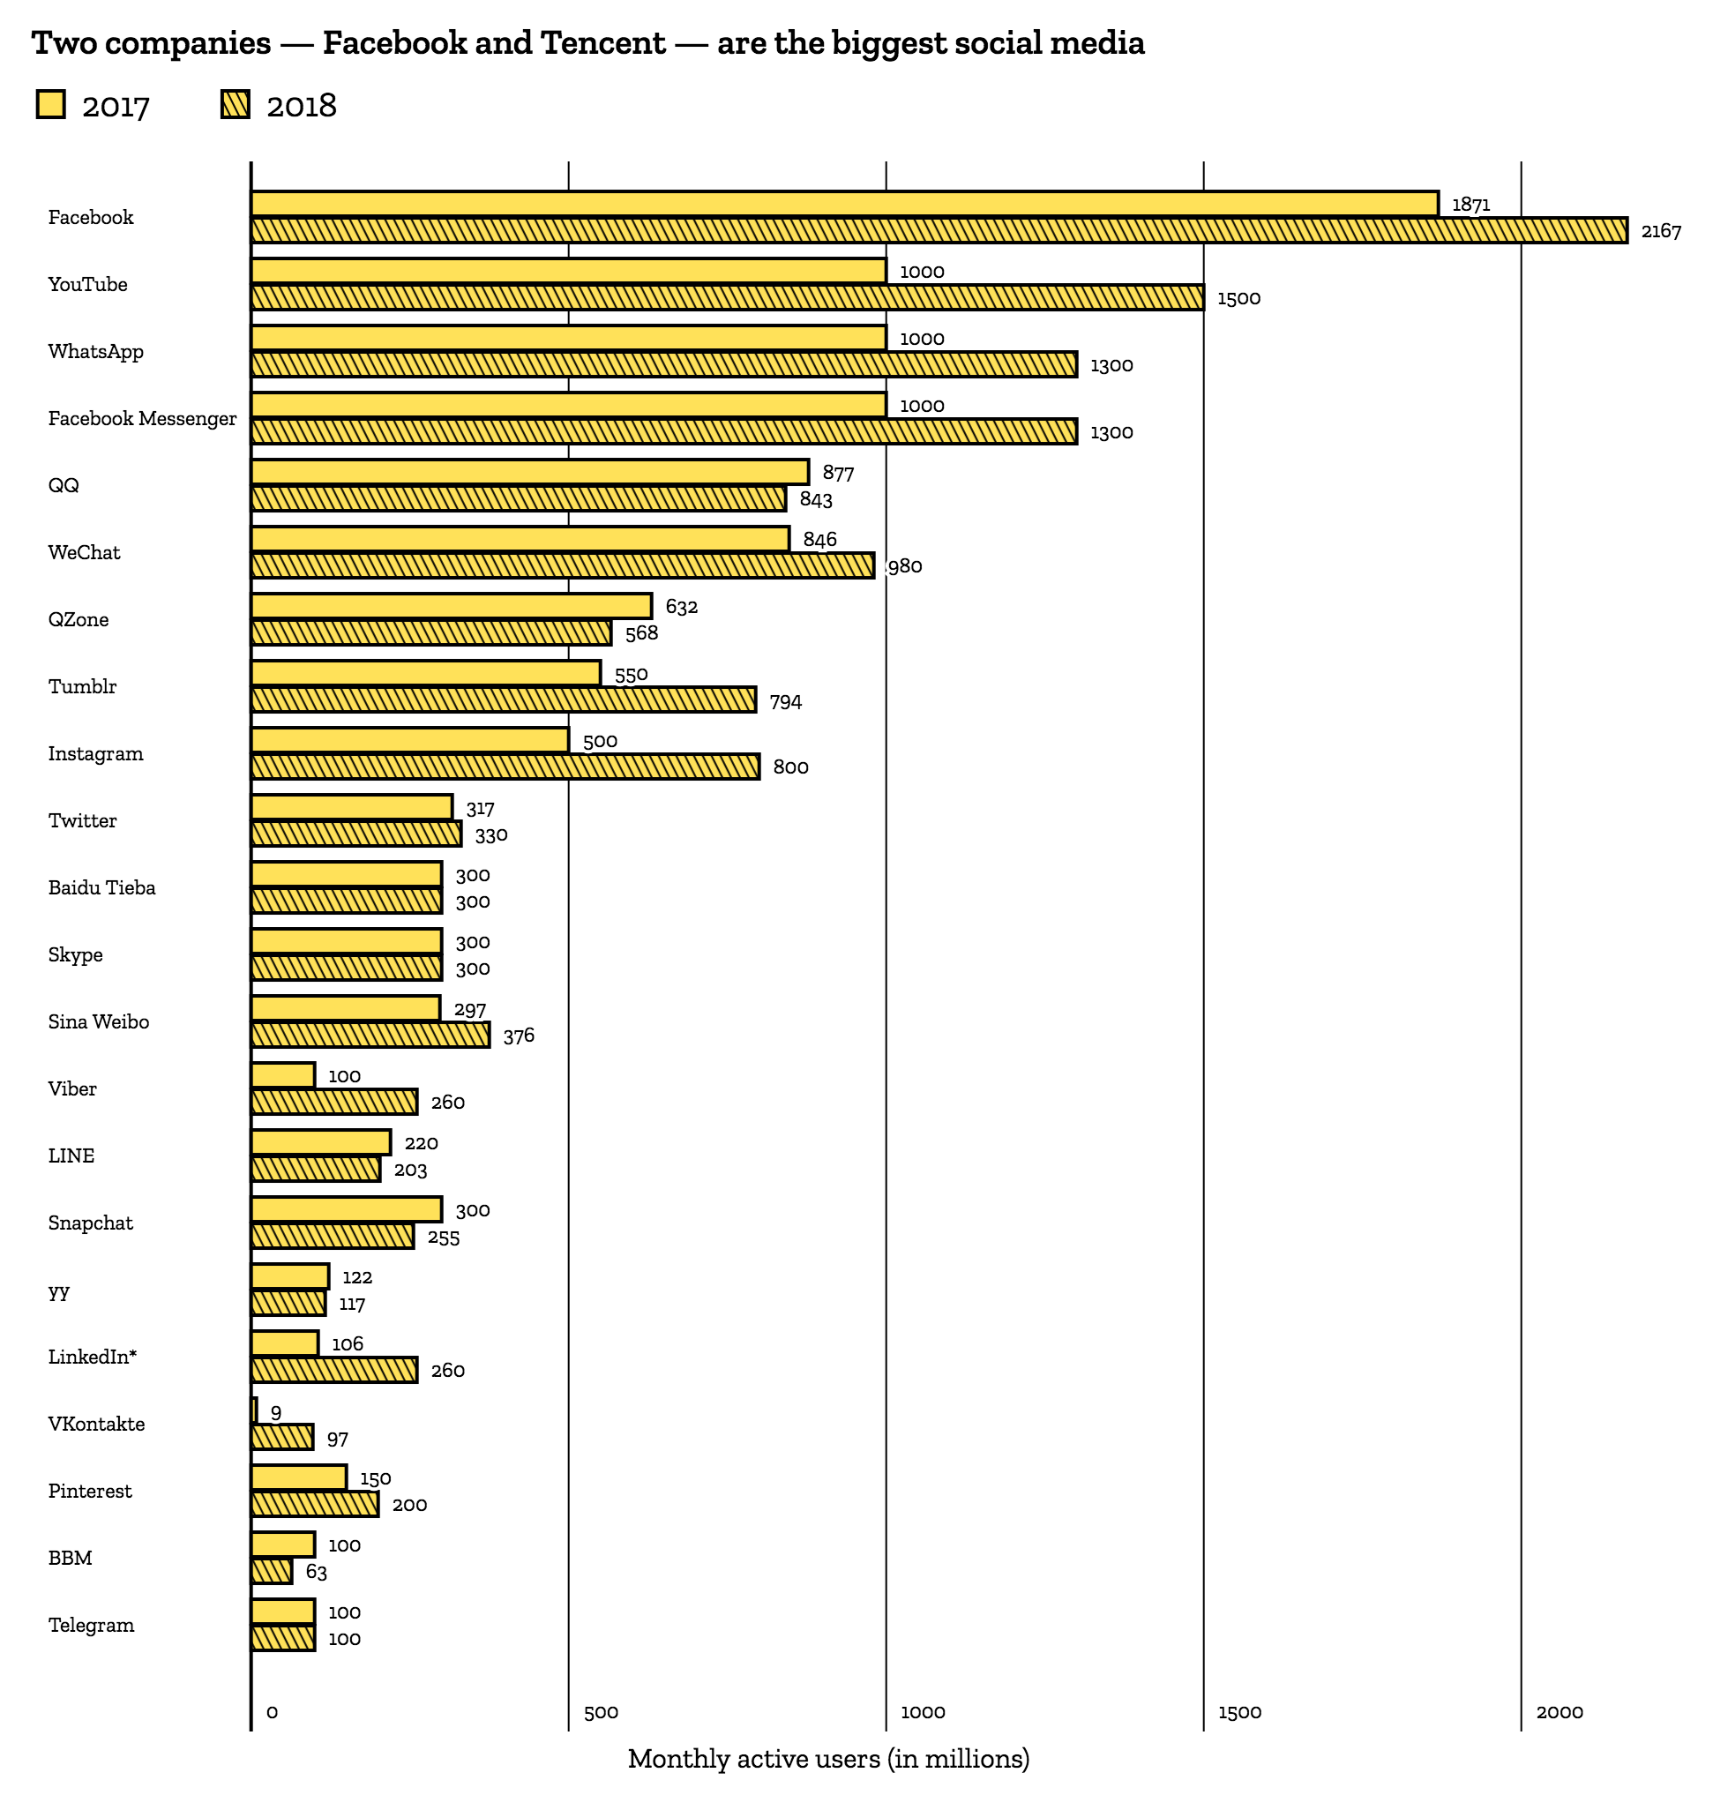
Internet Health Report
*Platforms have not published updated user figures in the past 12 months, figures may be out of date and less reliable.
**These platforms do not publish MAU data, user figures from third-party reports
Data source: Monthly active users of the most famous social networks, Statista, January 2018
Notes:
Three companies tower above all others in counts of combined monthly active users of the social media platforms they own.
Facebook owns: WhatsApp, Facebook Messenger and Instagram. Google owns: YouTube, and Tencent owns: QQ, WeChat and QZone.
Facebook is rocketing above the others, adding 1.196 billion users across its different platforms in just one year.
Read more: https://internethealthreport.org/2018/social-media-giants-facebook-tencent-google-reign/

Slide 20

Internet Health Report
What is it? The Five Issues Why Mozilla Cares What Can You Do?
So why does Mozilla care about this? Why should I care?

Slide 21
Internet Health Report
What is it? The Five Issues Why Mozilla Cares What Can You Do?
Online life is real life.
Notes:
There will be five billion of us on the Internet by 2020.
The Internet is a platform for our collective creativity, invention and self expression.
It’s also an increasingly necessary tool for basic everyday life: from banking to shopping, from accessing government services to connecting with friends and family.
Examples to choose from:
We are increasingly surrounded by connected devices meant to ‘help’ with every aspect of our lives — eating, walking, driving, growing food, finding a parking spot, running a city. This so-called Internet of Things will include 20.8 billion devices by 2020, all collecting and collating data constantly.
In 2017, residents of 26 countries experienced some type of governmental Internet censorship. Official justifications for the shutdowns ranged from national security concerns to school exams and noncompliance with the law.
4 in 10 Americans have personally experienced harassment online
There are nearly 2.5 billion people worldwide chatting, sharing stories and reacting to content on social media platforms. On average, each of these users spends the equivalent of 34 days a year on social networks. But these are’t public spaces: two companies — Facebook and Tencent — own the six top social networks.
Many of us get at least some of our news from social media, but at the same time over 40% of people surveyed across 9 countries said that they don’t trust social media to do a good job in separating fact from fiction.

Slide 22
Internet Health Report
What is it? The Five Issues Why Mozilla Cares What Can You Do?
We can make the Internet healthier.
Notes:
Our individual actions shape the health of the Internet ecosystem. Only by recognizing where the system is healthy can we take positive steps to make it stronger. Only by understanding where it’s at risk can we avoid actions that weaken it.
We can build new parts and teach people to get the most out of what’s there. We can point out what’s wrong and make it better.
If we do this kind of work together, we can expand and fuel the movement to keep the Internet much healthier for the future.

Slide 23
Internet Health Report
What is it? The Five Issues Why Mozilla Cares What Can You Do?
What can I do?

Slide 24
Internet Health Report
What is it? The Five Issues Why Mozilla Cares What Can You Do?
Read, download and share the report
Consider whether the internet is healthy where you are? Discuss it with those around you
Engage with the research and people in the report
Contribute to the 2019 report

Slide 25
Internet Health Report
Thanks! Please remember to visit:
mzl.la/ihr

